Slide 1

HR POLICIES
Organizations Must Have

Slide 2

Dr. Ikenna M. Okafor (OgaHR)
He has work experience cuts across the hospitality, energy (oil and gas), manufacturing, health, construction, real estate and currently in the mining sector. He is also a Faculty Member and the Deputy Registrar of the Integrated Institute of Professional Management (IIPM). He just got his Ph.D in Leadership, Manpower Development and Strategy.
Social Media Handle: Search for #SmeDoctor OR #OgaHR on Facebook and LinkedIn

Slide 3


Objective
Understanding the scope of HR Management
Justification for Policies
Policies Versus Procedures
Policies Samples
Formation of Policies and other Procedures
Challenges in Policy Formation
Possible Solutions to these Challenges
Factors Affecting Policy Formation
Conclusion and Questions

Slide 4



Introduction
It was noticed that there was high turn over in an organization and from discovery it was revealed that HODs could tell a staff to go home that the staff services were no longer needed.
At other times, the recruitment team could recruit family and friends thereby putting square pegs in round holes.

Slide 5

Introduction
Some policies are written while at some other times ancient practices becomes policies and at other times we use memos to correct, invent or introduce a policies.

Slide 6

Introduction
Policies can be used as an instrument for organizational growth and advancement, promote healthy culture and promote an agenda.

Slide 7
Objective
Understanding the scope of HR Management
Justification for Policies
Policies Versus Procedures
Policies Samples
Formation of Policies and other Procedures
Challenges in Policy Formation
Possible Solutions to these Challenges
Factors Affecting Policy Formation
Conclusion and Questions

Slide 8

JUSTIFICATION FOR POLICIES
Why should we have Policies in our organizations?

Slide 9

Introduction
Saves time for the organization

Slide 10

Introduction
Saves Cost

Slide 11

Introduction
Brings Equality

Slide 12
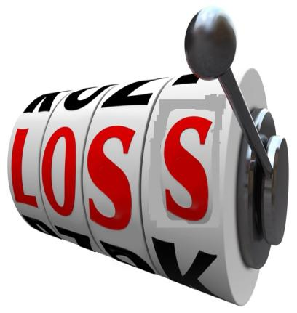
Introduction
Can be used as a tool to retain employees

Slide 13

Introduction
Reduces Fatigues and Fills Gap in Knowledge

Slide 14

Introduction
Eliminate the dangers of legal suit against the company

Slide 15

Introduction
Brings involvement

Slide 16

Introduction
Ensures continuity

Slide 17

Introduction
What else?

Slide 18
Objective
Understanding the scope of HR Management
Justification for Policies
Policies Versus Procedures
Policies Samples
Formation of Policies and other Procedures
Challenges in Policy Formation
Possible Solutions to these Challenges
Factors Affecting Policy Formation
Conclusion and Questions

Slide 19


POLICIES vs. PROCEDURES
Policies are set of rules and regulations guiding behaviours and the conducts of people within an organization.
Procedures are step by step guides on how a task or set of activities are to be carried out. In most clime, PROCEDURES are components of a POLICY

Slide 20
Objective
Understanding the scope of HR Management
Justification for Policies
Policies Versus Procedures
Policies Samples
Formation of Policies and other Procedures
Challenges in Policy Formation
Possible Solutions to these Challenges
Factors Affecting Policy Formation
Conclusion and Questions

Slide 21

NEED FOR POLICIES
The aim of a policy is to address certain gaps and loopholes in a system. Therefore, each policy being introduced should carter to a particular Human Resource Scope.

Slide 22
SAMPLES OF POLCIES
RECRUITMENT
PERFORMANCE MANAGEMENT
National Recruitment Policy
Expatriate Recruitment Policy
Equal Employment Policy
Annual Appraisal Policy
Employee Performance Reward Policy

Slide 23
SAMPLES OF POLCIES
EMPLOYEE RELATIONS
COMPENSATION & BENEFITS
Employee Handbook
Grievance Management Policy
Staff Disciplinary Policy
Workplace Harassment and Non-Discrimination Policy
Employee Communication Policy
Payroll Policy
Promotion and Demotion Policy
Cost of Living Adjustment (COLA) Policy
Leave Policy
Employee Benefits Entitlement Policy

Slide 24
SAMPLES OF POLCIES
GENERAL POLICIES
LEARNING & DEVELOPMENT
Sexual Harassment Policy
Document Management Policy
Training Policy for Senior Staff
Policy on Staff Development
Training Funds Policy

Slide 25
Objective
Understanding the scope of HR Management
Justification for Policies
Policies Versus Procedures
Policies Samples
Formation of Policies and other Procedures
Challenges in Policy Formation
Possible Solutions to these Challenges
Factors Affecting Policy Formation
Conclusion and Questions

Slide 26
Consultation
Identify the Gap
Formulation
Evaluation
Adoption and Implementation

Slide 27
Objective
Understanding the scope of HR Management
Justification for Policies
Policies Versus Procedures
Policies Samples
Formation of Policies and other Procedures
Challenges in Policy Formation
Possible Solutions to these Challenges
Factors Affecting Policy Formation
Conclusion and Questions

Slide 28


Challenges in Policy Formation
In forming a policy for an organixation, there are challenges that the players are likely to encounter.
Top Management’s interest must be protected
Having a policy that protects the company’s interest but appears to be inconsistent with the Fundamental Human Rights or laws of the country
Deliberate attempt by some factions to frustrate the formation of the policy

Slide 29
Challenges in Policy Formation
In forming a policy for an organixation, there are challenges that the players are likely to encounter.
Infleunces of the exitence of other competitors
Sector and Industry practice as well as industry culture
Failure to ducment certain policies.
Conpany’s location and proximity to factors of advantage or disadvantage.

Slide 30
Objective
Understanding the scope of HR Management
Justification for Policies
Policies Versus Procedures
Policies Samples
Formation of Policies and other Procedures
Challenges in Policy Formation
Possible Solutions to these Challenges
Factors Affecting Policy Formation
Conclusion and Questions

Slide 31


Possible Solutions to these Challenges
The use of diplomacy in dealing with parties of interest
Dialogue and lobby
Getting people involved

Slide 32

Possible Solutions to these Challenges
Consultation with your Legal Department and Legal Experts
Having employee engagement to sensitize the workers
Unification of policies and proper documentation to understand the SPIRIT and the LATER of the policy
Ensure that policy is in line with best practice

Slide 33
Objective
Understanding the scope of HR Management
Justification for Policies
Policies Versus Procedures
Policies Samples
Formation of Policies and other Procedures
Challenges in Policy Formation
Possible Solutions to these Challenges
Factors Affecting Policy Formation
Conclusion and Questions

Slide 34


Factors Affecting Policy Formation
There are two main factors affecting Policy Formation. They are as follows:
Internal Factors
External Factors
Let’s look at each in detail.

Slide 35
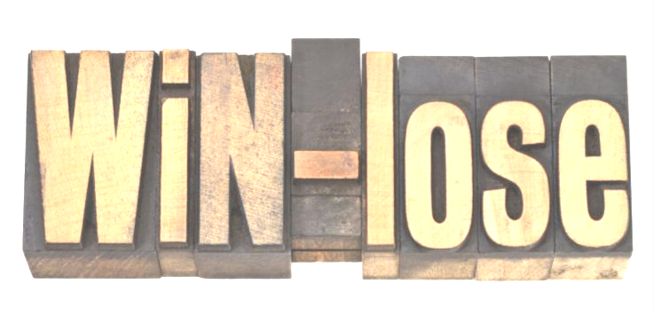
Factors Affecting Policy Formation
These are factors seen within the organization that affects the formation of policy. These could be negative or positive.
Using the SW-OT Analysis format, we can look at two variables:
STRENGTHS and WEAKNESSES
Internal Factors

Slide 36


INTERNAL FACTORS
STRENGTHS and WEAKNESSES
Gap identified within the organization. Breach of processes and procedures
When the Management especially the CEO has the business drive for processes and policies
Growth and expansion of the organization
Or
The introduction of a new action or task
Increased cost and loss recorded in the company. Loss could be human or material

Slide 37

Factors Affecting Policy Formation
These are factors that the organization has little or no control over. The actions of state and non-state actions often than not inform the behaviour of businesses around the globe.
The external factors could be action of states, country, other countries, and could be seen and unseen.
External Factor

Slide 38
EXTERNAL FACTORS
OPPORTUNITIES AND THREATS
Favourable Government Policies
OR
Unfavourable Government Policies
Economic and political realities of the country at the time.
Natural Disasters like drought, flood, war, epidemic and pandemic.
Activities of other competitors and other non-state actions

Slide 39

QUESTION
&
ANSWER

